Slide 1
Angular *.*.* Unit Testing
High level understanding of jasmine and karma for angular

Slide 2
Jasmine:
Jasmine is an open source testing framework for JavaScript
It runs on any JavaScript-enabled platform.
Aims to have easy to read test cases
Jasmine comes with inbuilt test runner, supports Nodejs, Python, Ruby by using Karma a simple JavaScript test runner tool.
https://jasmine.github.io/setup/nodejs.html
Karma:
1.Karma is a test runner for JavaScript that runs on Node.js
2.It is widly used by popular test frameworks like Mocha, QUnit, Jasmine etc
3.It needs a native browser to be active in order to operate.
https://karma-runner.github.io/3.0/intro/how-it-works.html

Slide 3
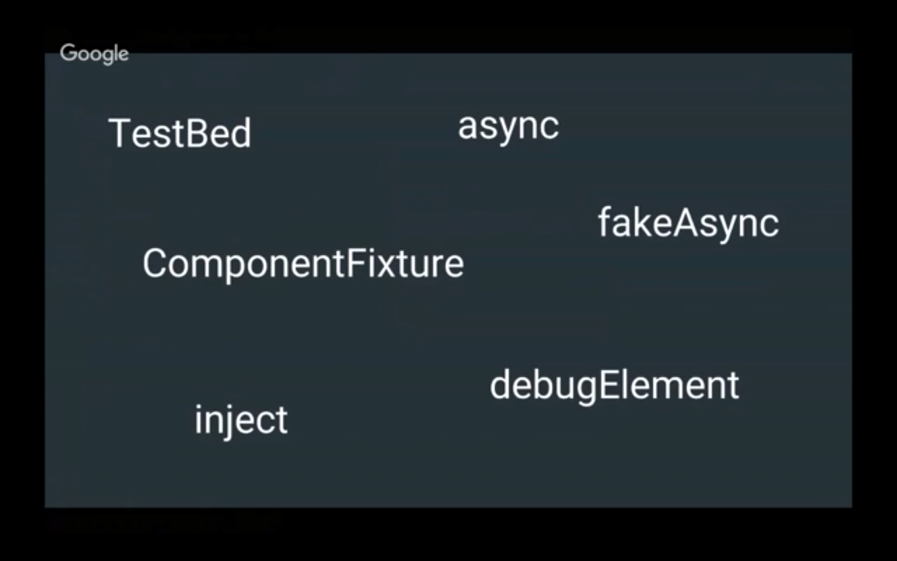
Goal : To gain an understanding on the following angulr wrappers on top of jasmine

Slide 4
Sample Jasmine code:
describe("MathUtils", function() {
var calc;
//This will be called before running each spec
beforeEach(function() {
calc = new MathUtils();
});
describe("when calc is used to peform basic math operations", function(){
//Spec for sum operation
it("should be able to calculate sum of 3 and 5", function() {
expect(calc.sum(3,5)).toEqual(8);
});
//Spec for factorial operation for negative number
it("should be able to throw error in factorial operation when the number is negative", function() {
expect(function() {
calc.factorial(-7)
}).toThrowError(Error);
});
});
});

Slide 5
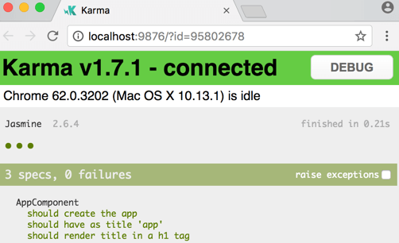
Karma test runner in operation

